Slide 1
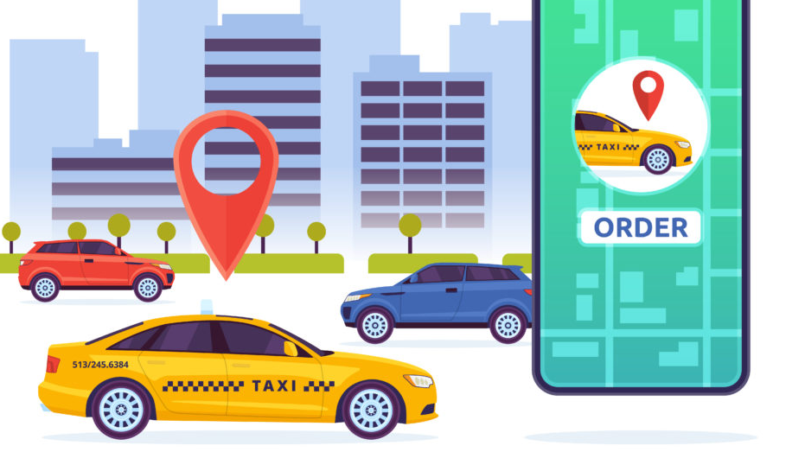
MUJ Cab Sharing app
Ishaan sharma-209301331 Guide-Ms Deepti Sharma
Shivam Agrawal-209302215

Slide 2
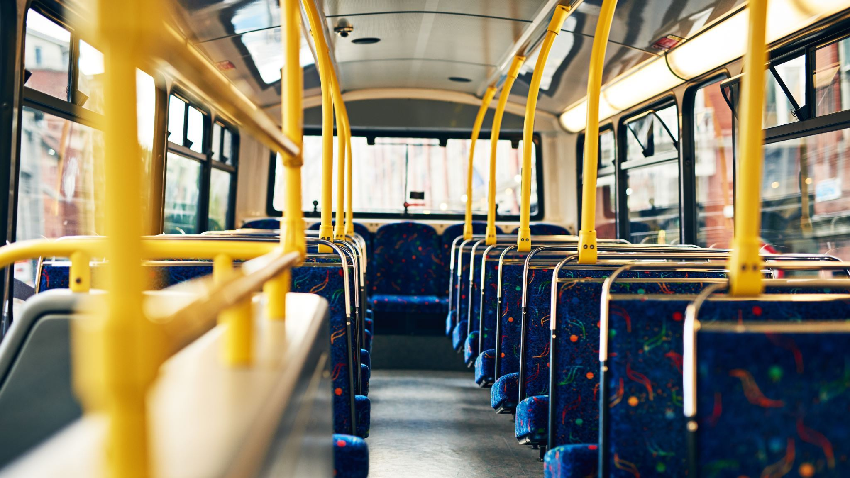
Project description
The Cab Sharing application will provide a platform for users to book cabs on their preferred routes, so that their fare can be minimalized.
Giving the users a choice to select the best suitable ride, depending upon the fare offered by the driver and the timing on which the cab operates

Slide 3
Primary screens
Map Screen
Cab Selection
Profile Creation
Ride booking confirmation
Review System

Slide 4
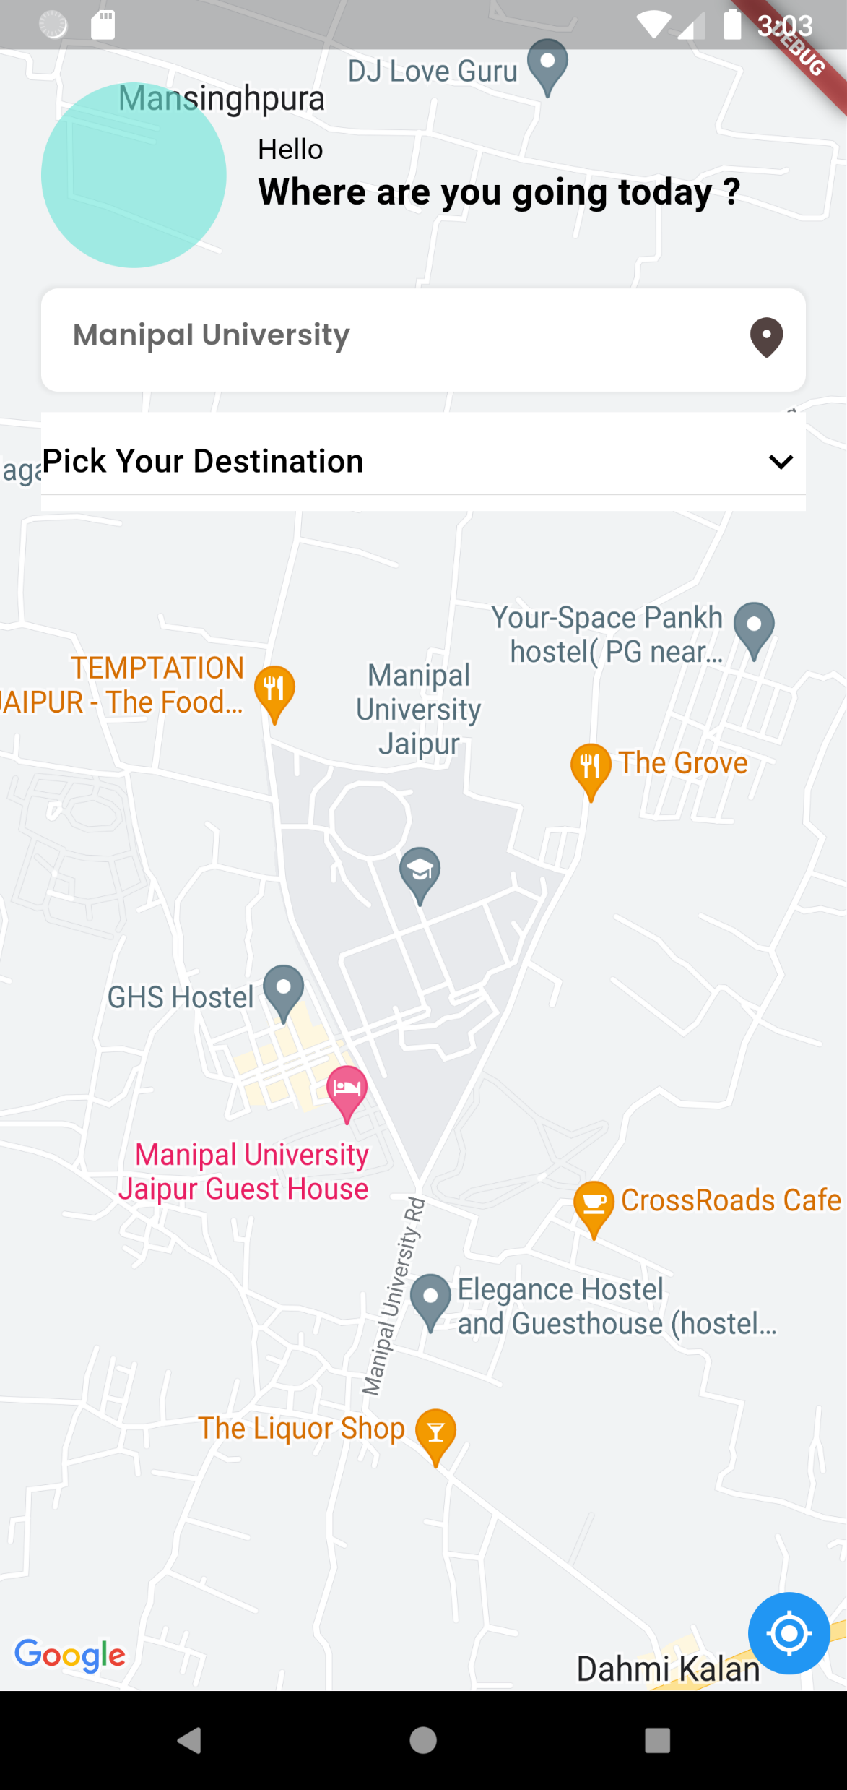
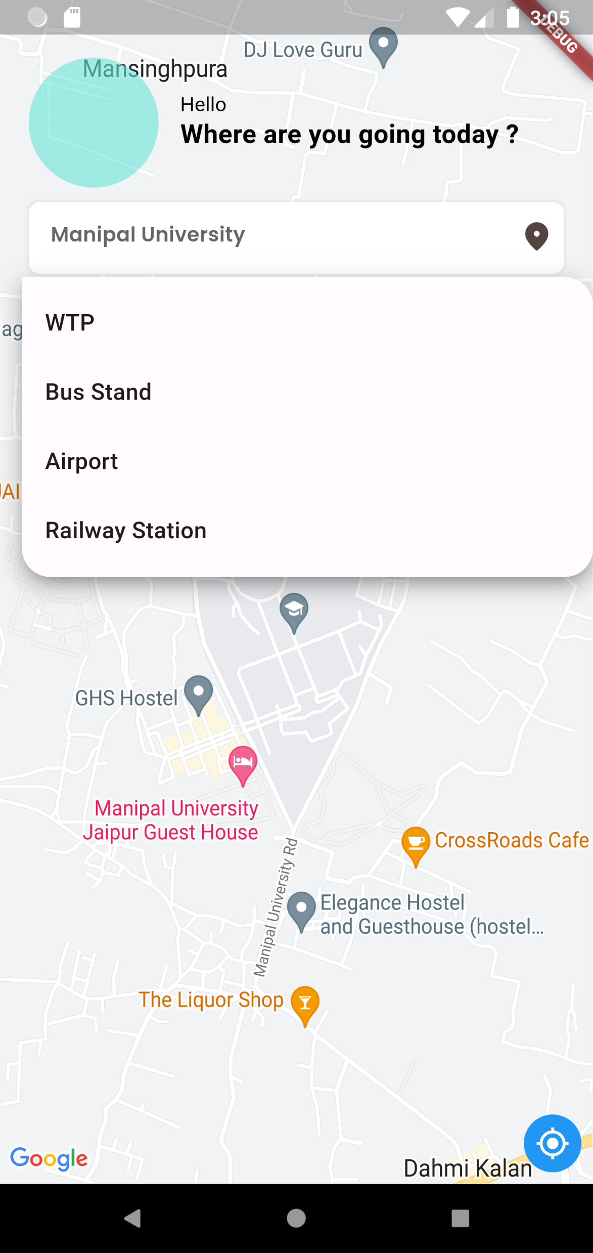

Slide 5
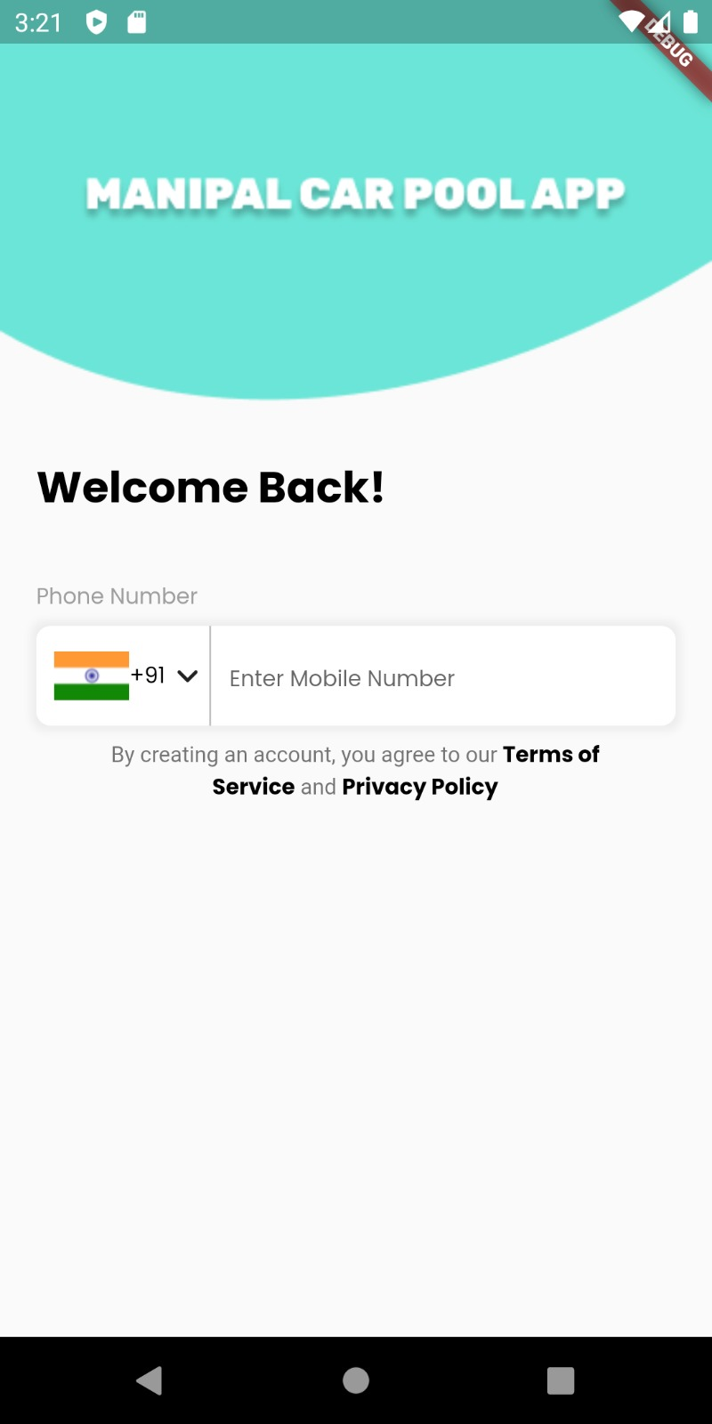
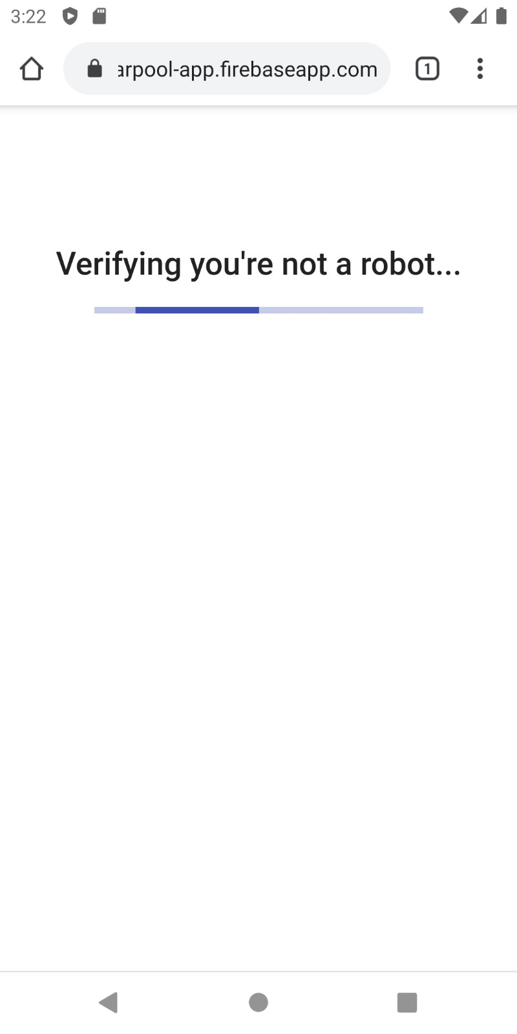

Slide 6
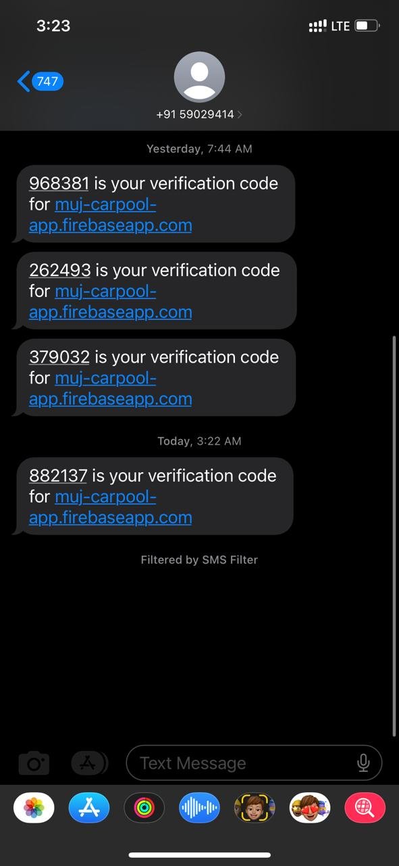
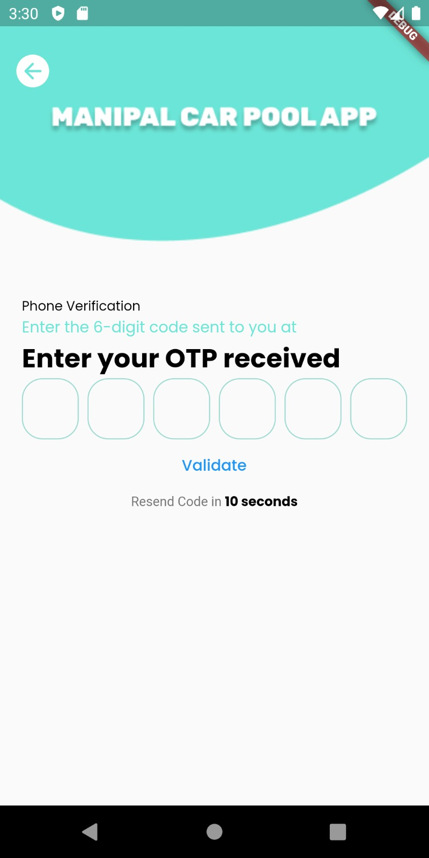

Slide 7
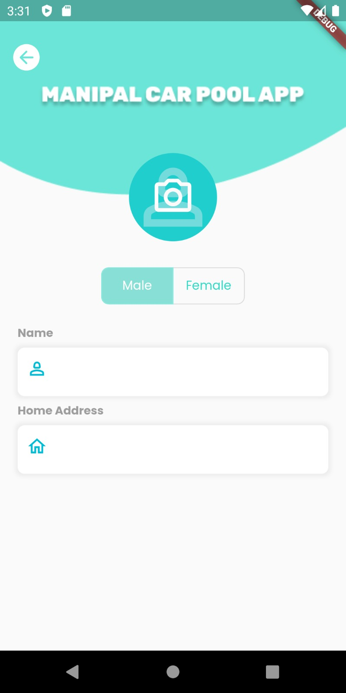

Slide 8
Phase 2-Future work
Driver Profile Creation
Generating personal request
Route Declaration by drivers
Recommendation of Drivers
Carpool
Payment gateway

Slide 9
Timeline
Map Screen -(completed)
Login page -(completed)
Profile Creation -(completed)
Cab Selection – 31/03/2023
Ride booking confirmation –7/04/2023
Review System- 14/04/2023

